Slide 1
AI Applications in People Management
AI Application in HR
Matthew Bidwell, Associate Professor of Management

Slide 2
AI Applications in HR
Figure out what kind of data we are going to use
What data can we use to make these predictions?
How would we actually use these algorithms?
Engagement
Attrition
Internal career paths

Slide 3
AI Applications in People Management
AI and Engagement
Matthew Bidwell, Associate Professor of Management

Slide 4
Sentiment Analysis
Basic principle is looking at emotion in text
Starts with a pre-defined dictionary of words
Long list of all of the words we associate with positive emotions and another lost list of all of the words we associate with negative emotions
Count the number of words with positive emotions and words with negative emotions
Compare the frequency differences between them

Slide 5
Sentiment Analysis
Obvious problems
What if somebody says that they are "not happy"
Contorted example — “Inadequately excited”
Differences in how people express themselves
People might be strategic, particularly if they know we are looking at what they say

Slide 6
Sentiment Analysis
Accuracy considerations
Decent correlations with human raters
The accuracy of any one piece, particularly a short piece of text, could be questionable
When you look at large bodies of text, or text written by a variety of different people, generally the accuracy is pretty good

Slide 7
Where Do We Use Sentiment Analysis?
Tradeoff between comprehensiveness and invasiveness
Emails and instant messages
Legal and ethical issues
What people post about the company on social media
If it's on social media, it's public
Can give you a sense of overall morale, and a warning when things are changing, but not to the granularity of emails
Open-ended pulse survey questions— just asking people for a couple of sentences on how they feel, on a more regular basis

Slide 8
AI Applications in People Management
Topic Modeling
Matthew Bidwell, Associate Professor of Management

Slide 9
Topic Modelling
A technique for extracting meaning from text data through themes
Trying to figure out the key themes being talked about in large bodies of text
Being able to code each of the different pieces of text to tell you which theme is present

Slide 10
Topic Modelling Example
“Very strong culture, people genuinely loved each other and working there. There was very much a "work hard, play hard" mentality.”
“A young and inclusive team-based environment that cherished flexibility and hard work.”
“Our culture was very collegial and impact-oriented. Working on big societal challenges attracted people who were very driven, purposeful, and passionate about their work. There was also a strong spirit of collaboration and respect across programs and hierarchies.”

Slide 11
Assumptions of a Topic Model
Words
Topics
Documents
Wibble
F’tang
Aark
Ribbet
Wiing
Aggle
Blang
Riggon
Krogg
Topic A
Text 1
Topic B
Text 2
Topic C
Text 3
Topic D

Slide 12
Topic Modelling
Important limitations
We have to tell it how many topics (themes) to look for
It doesn't tell us what those topics are about
We have to try to figure that out from the words associated with the topic
As a way of extracting the key themes from large volumes of text it can be quite impressive

Slide 13
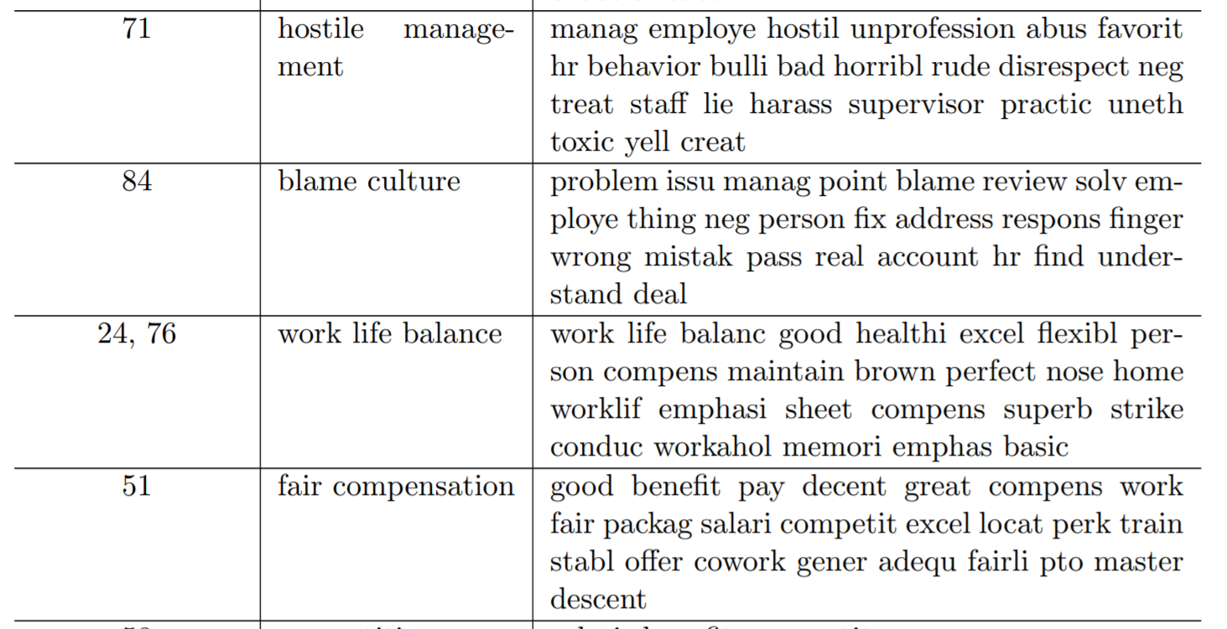
Measuring Culture Across Organizations

Slide 14
Topic Modelling
Application
Idea is that you can take whatever open text you have
Pulse surveys — employee responses to open ended questions
Use this technique to distill it into the key themes
Can then look at how these themes emerge over time or distribute across departments

Slide 15
AI Applications in People Management
AI and Attrition
Matthew Bidwell, Associate Professor of Management

Slide 16
Attrition Overview
In trying to figure out which of our employees might leave, what information would we look at?
Personal circumstances and where they are in their career
Current job
Some roles have high attrition
Signals of engagement
Whether things are going well at work
How withdrawn are they?

Slide 17
Building ML Models of Attrition
Use machine learning to combine these characteristics in a systematic way
Using past data on which people stayed or left
Idea is to understand how each of these characteristics might feed in to a prediction model
Advantages
Accuracy
Doesn’t get distracted — keeps monitoring when we have moved on

Slide 18
AI Applications in People Management
Building ML Attrition Models
Matthew Bidwell, Associate Professor of Management

Slide 19
Building ML Models of Attrition
What are some of the factors that matter?
Demographics, job role
Transaction level data
Data on specific events that have happened to people that also shape their probability of leaving

Slide 20
Transaction Level Data — What Changed?
Receiving a signal that they are not being valued as highly within the organization
Changes in performance evaluations
Reduced raises and bonuses
Turned down for promotion
Rejection from other roles within the company
Disruptions in their environment
Colleagues are leaving — “turnover contagion”
Loss of manager
Reorganizations

Slide 21
Building ML Models of Attrition
What are some of the factors that matter?
Demographics, job role
Transaction level data
Data on specific events that have happened to people that also shape their probability of leaving
Behavioral data
What are people actually doing day to day?

Slide 22
Behavioral Data
Sudden declines in performance or productivity
Information from how people are interacting with others
Those who have more contacts are more likely to stay
Those who have fewer contacts are more likely to leave
Also evidence that the quality of those contacts matters

Slide 23
Quality of Interactions
Study by a group of researchers at Stanford and Berkeley looking at what people said in their emails to each other
Similar language suggest a stronger relationship and deeper understanding of culture
Divergence in language predicted that a person would leave the organization

Slide 24
Social Media
Push factors — how people are being “pushed” out of an organization
Pull factors matter as well — are people being “pulled” by the prospect of a better job elsewhere
Most people tend to find jobs through their networks
Online networking has made those searches visible
Can track if people are searching for new jobs — if they are, they may be more likely to leave

Slide 25
AI Applications in People Management
The Value of Attrition Models
Matthew Bidwell, Associate Professor of Management

Slide 26
Why Model Attrition?
More insight about the levers that affect turnover
Experiences at the beginning of employment influence attrition
Whether or not a manager scheduled a 1-on-1 meeting with a new employee in their first week
If an employee’s new team sent someone down to collect them from new hire orientation vs. when a new hire was expected to find their own way
Allow for early intervention
If we know more about who is a flight risk, then we know who to focus on
Many organizations will do a "stay interview”
Proactive interventions based on flight risk models can be effective

Slide 27
Why Model Attrition?
Planning for replacements
We can’t prevent all attrition
Not all attrition is regrettable
If we can predict when people are likely to leave, we can plan ahead to minimize disruption
Manage succession internally
Planning how many people we’re going to need to hire

Slide 28
AI Applications in People Management
AI and Careers
Matthew Bidwell, Associate Professor of Management

Slide 29
Why Manage Careers?
Why do organizations care about the management of their employees’ careers?
Companies care about attrition, and people often leave firms to advance their careers
If we make it easier for people to advance their careers within the organization, they are less likely to leave us

Slide 30
A Bit of History
Traditionally, organizations had really well-defined career ladders
Part of the expected contract for workers
Things started to change over the last 20-30 years
Organization structures changed — from hierarchical bureaucracies to flatter, more fluid organizations
Organizations drew back from paying attention to their employees careers
Starting to see more organizations making attempts to build clearer career paths internally
Can be quite complicated
Machine learning is an opportunity for organizations in rebuilding these career paths

Slide 31
Predicting Job Paths
Make it easier for people to find jobs
Helping people understand what jobs are open to them
Making it easier for recruiters to find existing employees who would be good candidates for those roles
Helping people understand the longer term career paths
Helps them direct their search for the next job
Gives them confidence that they can grow their career within the firm
Guide development

Slide 32
Predicting Job Paths
Early example: IBM Watson Career Coach
Tool that employees could interact with to explain their preferences for their careers
Watson would take their preferences and combine it with data on possible career paths to provide guidance, with the goal of increasing retention and engagement

Slide 33
Approaches for Developing Career Recommendations
Analyze the career paths of those who have come before
Works well for common roles
In a fast moving environment, just relying on prior roles might not be that effective

Slide 34
Approaches for Developing Career Recommendations
Draw career paths based on skills
Look for a match between skills and the skill demands of different jobs
Identifying new career paths that people haven't taken yet
Paths in and out of new jobs
The main barrier to using data on skills is that we often don’t have very good data on skills
We need to know the skill demands of different jobs and what skills people actually possess

Slide 35
AI Applications in People Management
Analyzing Skills
Matthew Bidwell, Associate Professor of Management

Slide 36
How Do We Measure Skills?
Ask the employees
Ask them to create a list of skills they possess
Ask them to continually update that profile as they continue to learn new things
One of the challenges is getting people to fill out the profiles and keep them up to date

Slide 37
How Do We Measure Skills?
Create strong incentives for people to report their skills
Can we create internal profiles and get people to fill in their skill data?
Often suffer from a chicken and egg problem

Slide 38
How Do We Measure Skills?
Make identifying skills part of the formal performance appraisal process
Requires getting employees to take the exercise seriously
May be uses for AI here
Suggest skills that employees might have based on data such as:
The projects that they have worked on
The job they’re in
Even documents that they have written over the year

Slide 39
How Do We Measure Skills?
Infer employees’ skills from the jobs that they held in the past
Need to know what skills are associated with each job
O*Net
Took 900 occupations and coded the skills and abilities that people are expected to have in those occupations
Very simple
Challenge is it assumes that every job within each occupation requires the same skills — they don’t
Common approach for organizations getting a first understanding of skills present in the organization based on the jobs people are doing

Slide 40
How Do We Measure Skills?
Infer employees’ skills from the jobs that they held in the past
Job descriptions
Formal job analysis
Job postings

Slide 41


